Slide 1
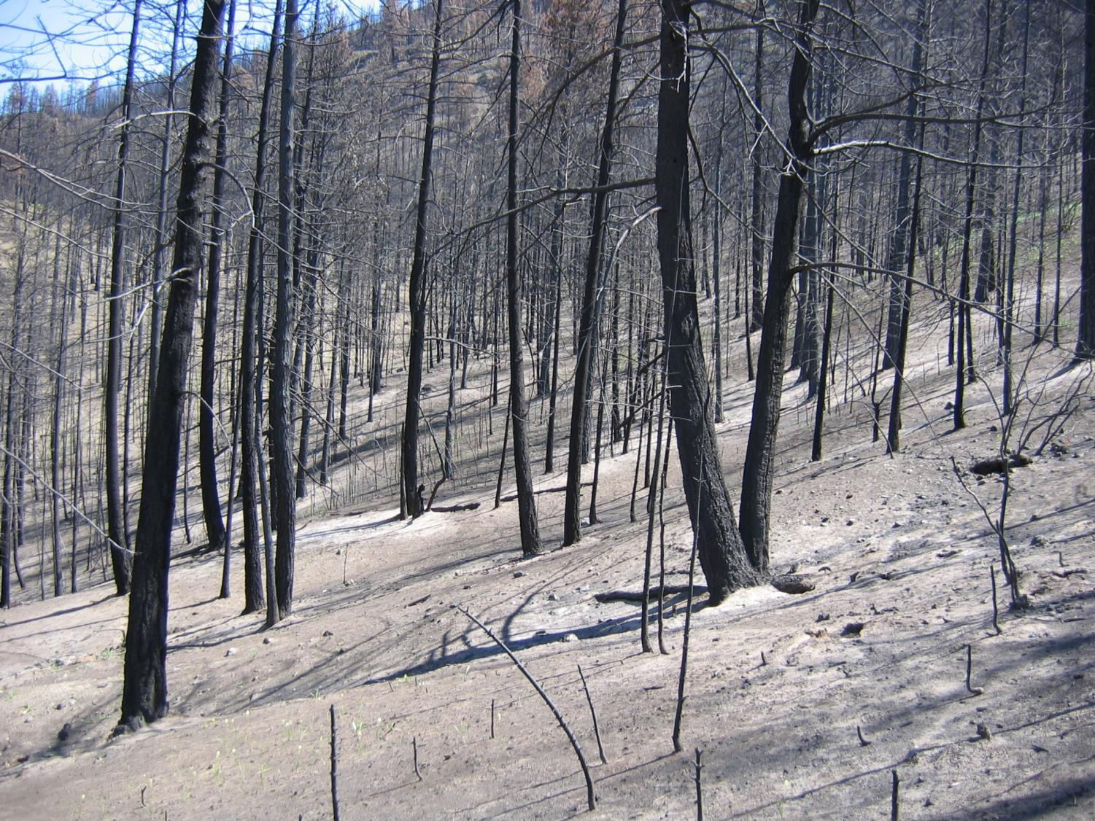
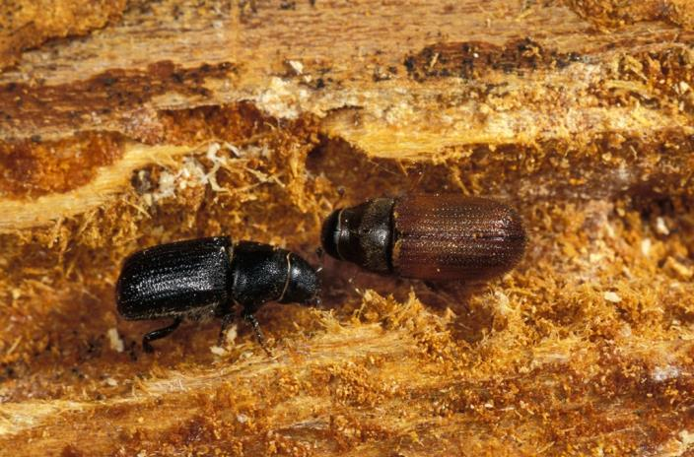
Wildfire and Douglas-fir beetle: risk and management
Lorraine Maclauchlan
Thompson Okanagan/Cariboo Regional Entomologist

Slide 2
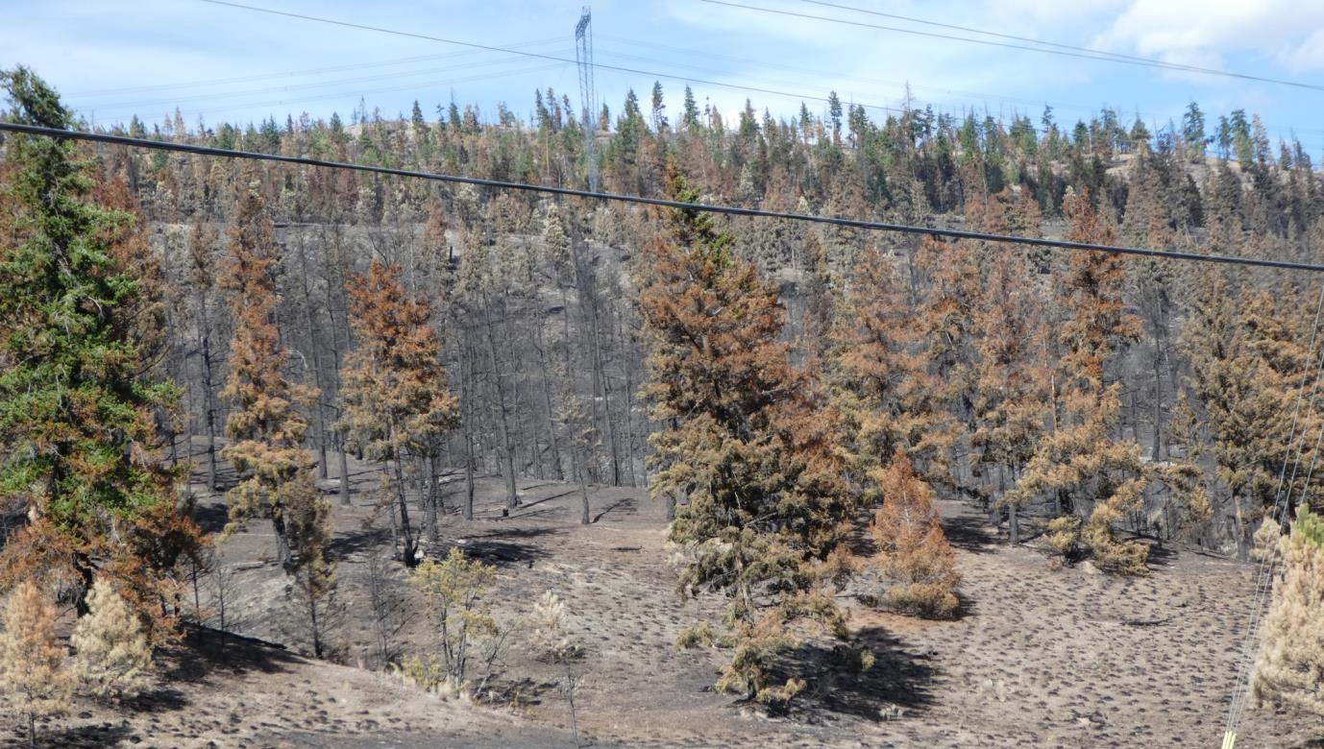
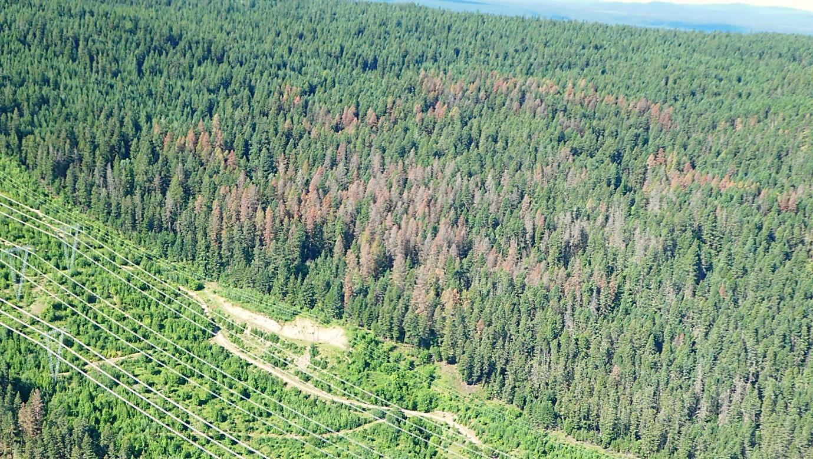
The worst case scenario . . .
Numerous and extensive wildfires in Douglas-fir
Pre-existing Douglas-fir beetle activity (outbreak)
This is the worst case scenario!

Slide 3
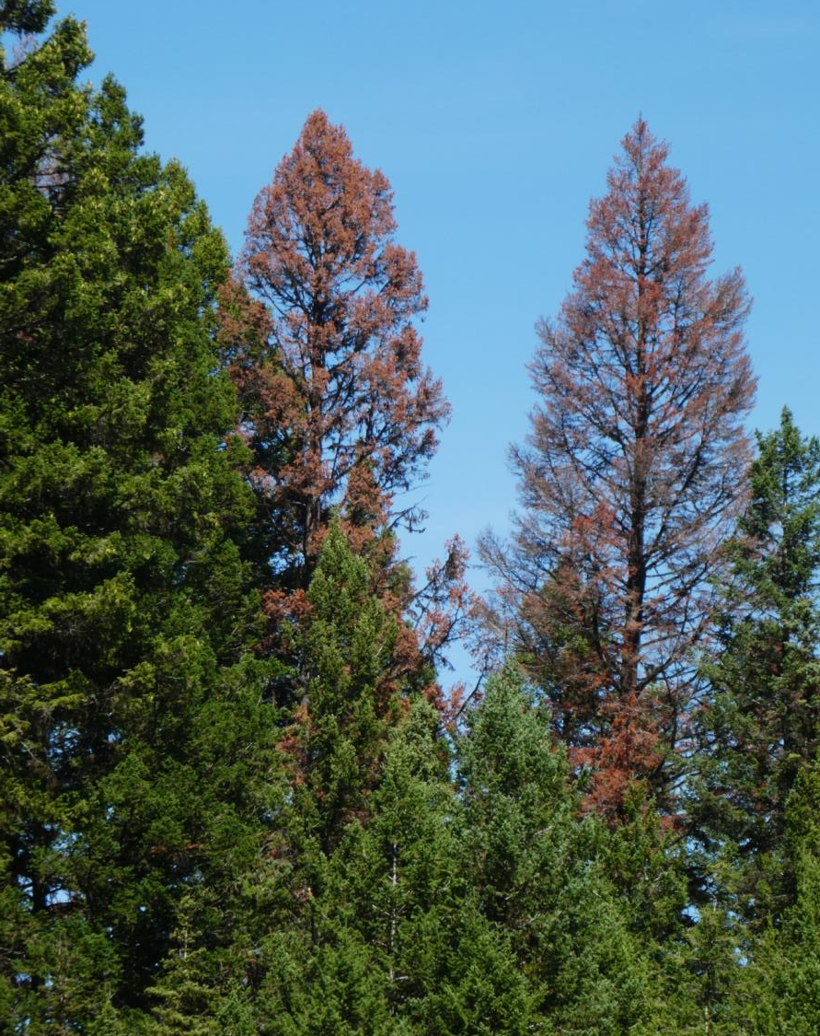
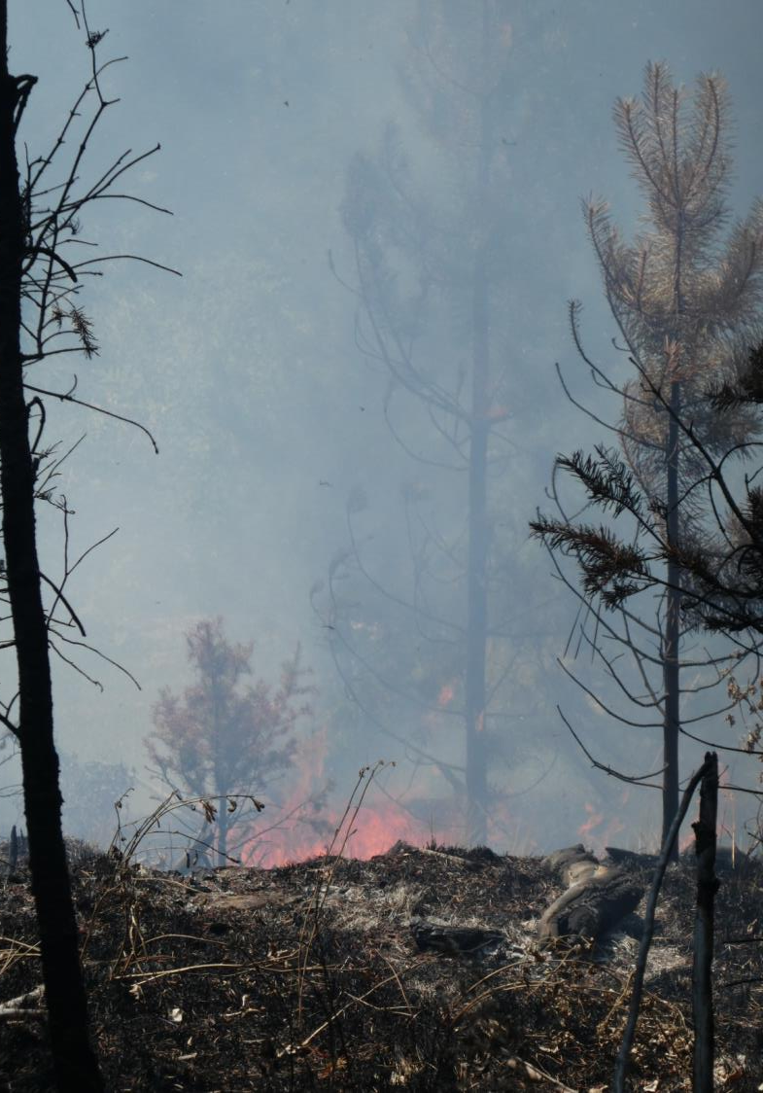
The worst case scenario . . .
Area burned exceeds harvest capacity.
Salvage priorities for burnt wood versus DFB infestations.
Short time window for fire salvage & maximum DFB extraction.
DFB attack expanding in green wood.
DFB will colonize burnt areas in 2018 and further expand.
DFB will utilize burnt trees 1-3 years then move to green fir.
Pressure on mid-term timber
Harvest priority balance

Slide 4
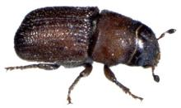
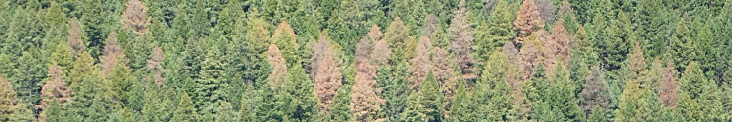
Processing the situation . . . need to know.
The B.C. situation: fire and beetle
Douglas-fir beetle: host selection, signs, symptoms
Post-fire environment: things you must consider
burn severity and risk to DFB
other resource values (water, soils, MDWR, OGMA and others)
critical timelines
management and protection of green fir

Slide 5
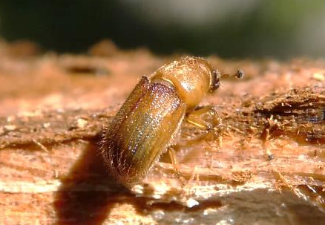
The B.C. situation: fire and beetle
The current Douglas-fir beetle outbreak cycle is showing more concentrated, severe areas of attack throughout the range of the outbreak.
The outbreak is widespread throughout most Douglas-fir types in B.C. and not showing signs decline yet.
Notes:
Douglas-fir beetle experiences periodic, rather eruptive outbreaks throughout the range of Douglas-fir in B.C. Outbreaks are more common and widespread in the interior and typically last 5-6 years.
The current DFB outbreak cycle is showing more concentrated, severe areas of attack throughout the range of the outbreak.

Slide 6
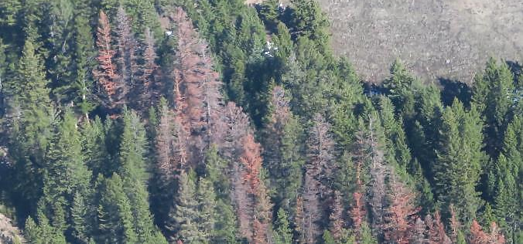
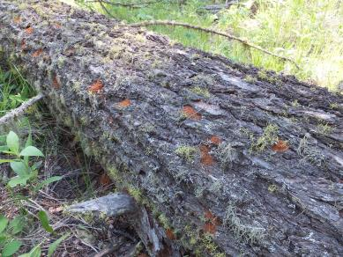
South Area
Douglas-fir beetle
Dendroctonus pseudotsugae
OGMA’s
MDWR
Interface
Soils – water
Fire
Notes:
The majority of burnt area is in Douglas-fir forests.
Burn severity must be compared to DFB Hazard Rating maps to assist in prioritization process.
Current DFB locations must be compared to burn severity – some DFB within fire perimeter, other populations in green wood.

Slide 7
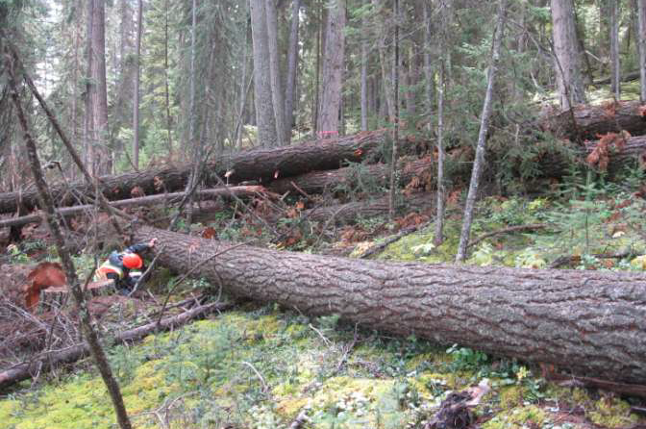
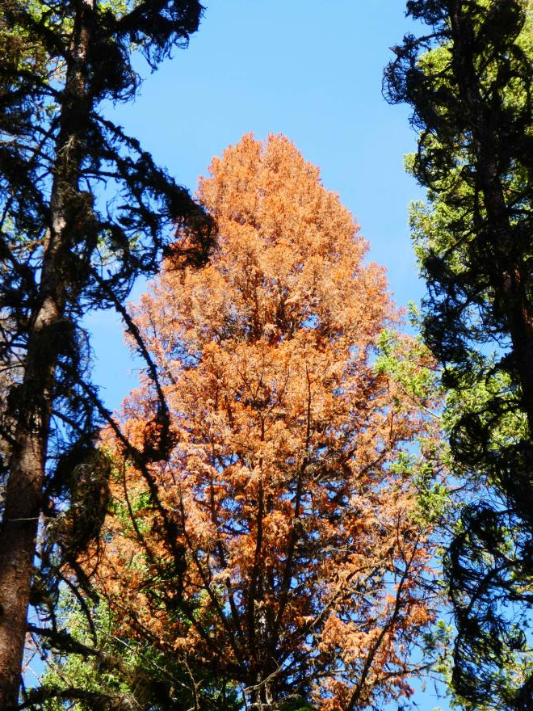
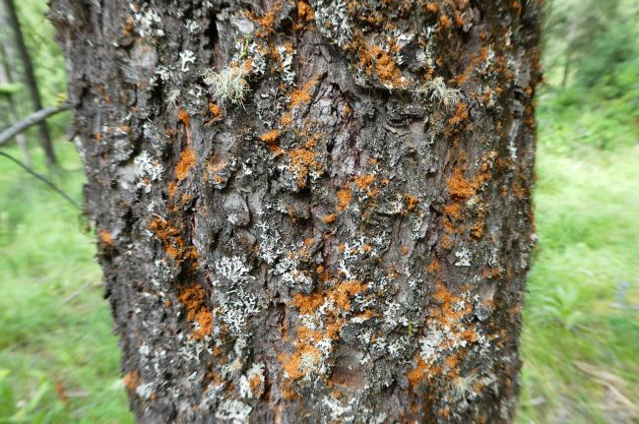
Douglas-fir beetle: host selection, signs, symptoms
Downed trees
Frass on bole
Red crowns

Slide 8
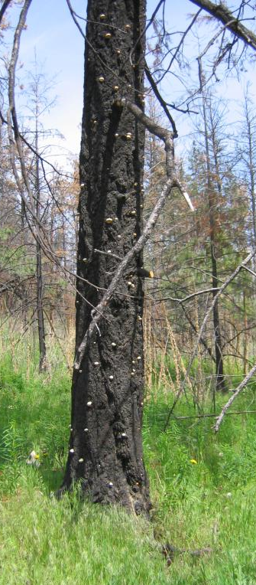
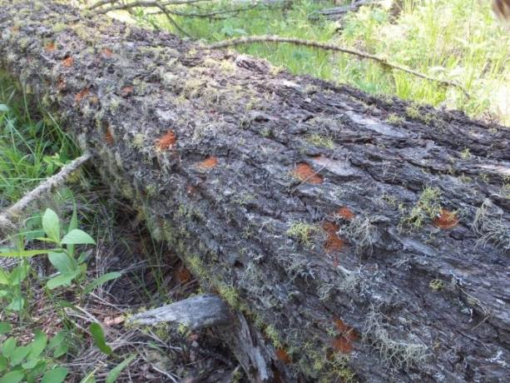
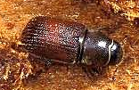
Outbreak Triggers for Douglas-fir beetle:
wind/snow events causing breakage or wind throw (DFB prefer freshly down material)
fire-scarred or damaged trees
unseasonal weather
drought events stress host trees
natural outbreak periodicity
Douglas-fir beetle attracted to fresh wind throw & fire-scorched trees
Notes:
wind/snow events that cause breakage or blowdown in Df, Sx or Bl
unseasonal weather (early spring, hotter, colder)
drought events
FIRE scorch
All conditions have been met.
Snow could recede from trap trees earlier in the spring (with changing climates) allowing Douglas-fir beetles to emerge & fly earlier.
NB. When using trap trees as control – be attentive to these early, warm spring seasons and ensure all trap trees are removed from sites prior to adult emergence.
Warmer, longer summers could allow for a more pronounced and damaging second flight of fir beetle.

Slide 9
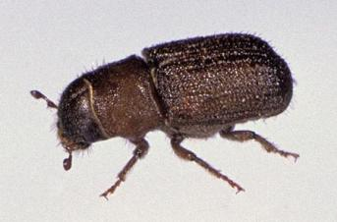
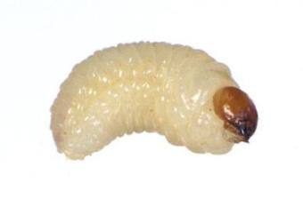
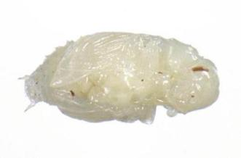
Dendroctonus pseudotsugae
ADULTS
Winter
1st
May -
June
1 year
Life Cycle
Aug. -
Sept.
EGGS
2nd
ADULTS
Mid-May to
Mid-August
PUPAE
LARVAE
Flight period
Main Flight
Complete Flight Period
March
April
May
June
July
August
Notes:
The adult attacks in the spring and lays eggs generally in may and June

Slide 10
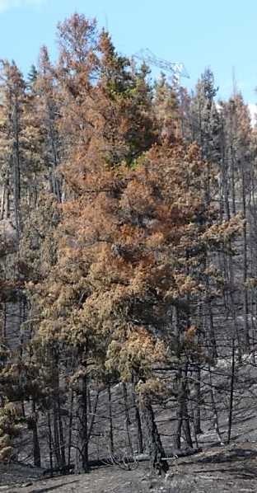
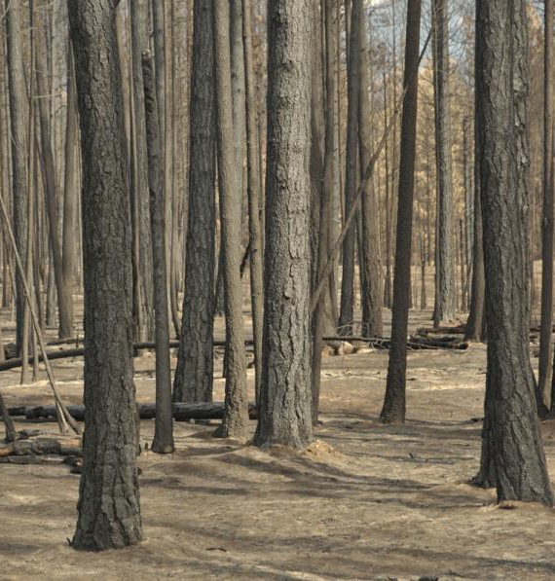
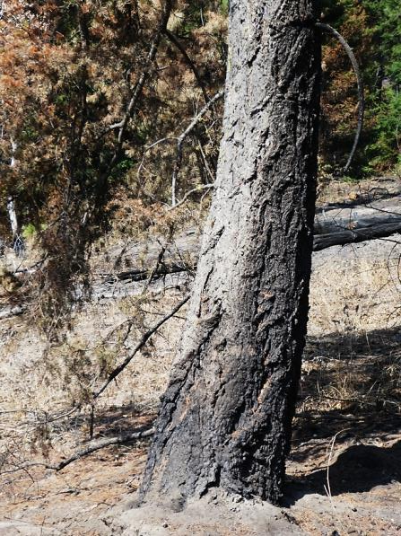
Recognizing Douglas-fir beetle attack and secondary insect attack
Signs & symptoms on bole
Crown symptoms
Time of year – beetle biology
Early summer burn
Bole scorch
Crown scorch
Late summer burn

Slide 11
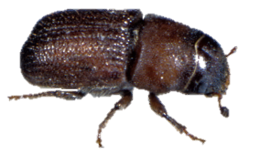

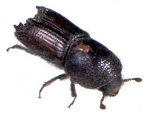
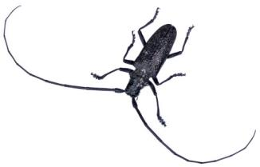
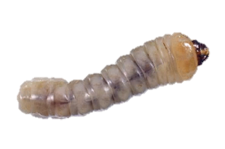
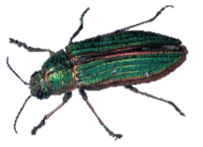
Key insect damage occurring post-fire:
Bark beetles, woodborers, ambrosia beetles, wood wasps and others are attracted to fires and fire-damaged hosts.
Each type of insect has its unique “signature”.
Bark beetles
Secondary bark beetles
Decomposers (woodborer, ambrosia beetle, wood wasp, ants)

Slide 12
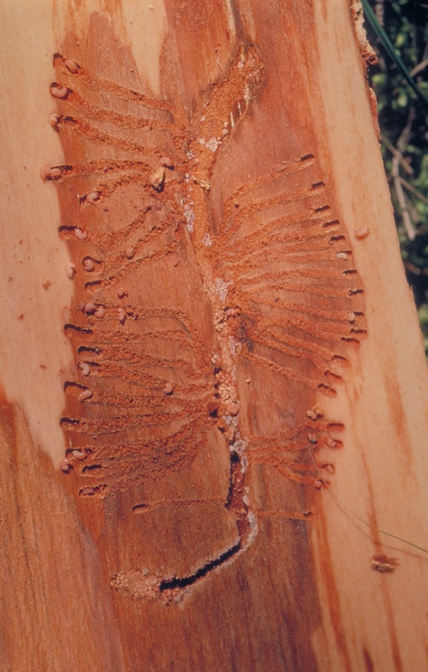
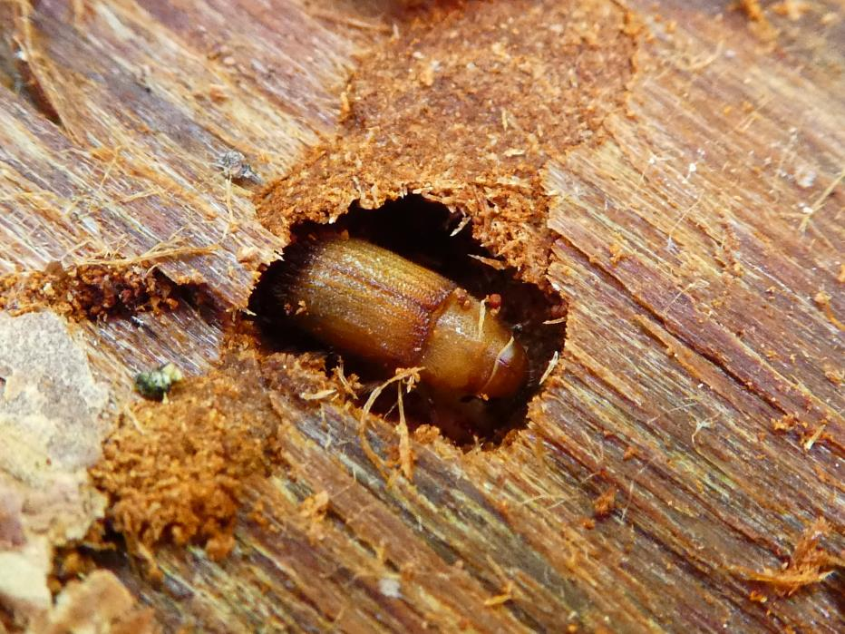
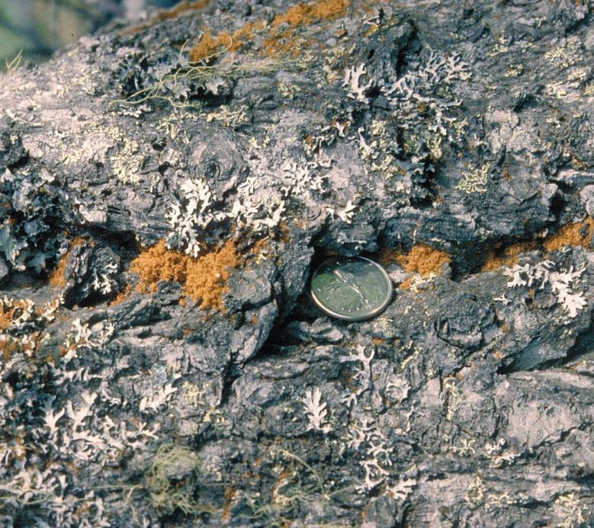
Must verify DFB attack:
scorched bole with red frass
diagnostic gallery under bark
live beetles (larvae, pupae, adults)

Slide 13
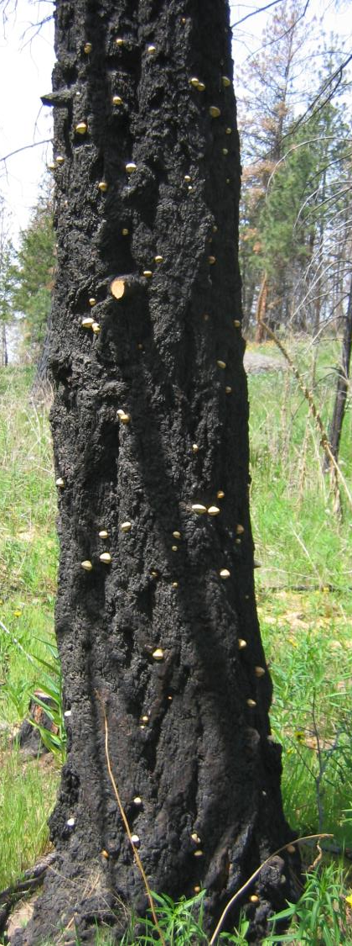
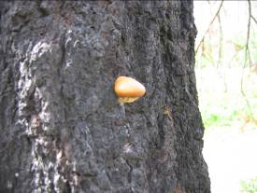
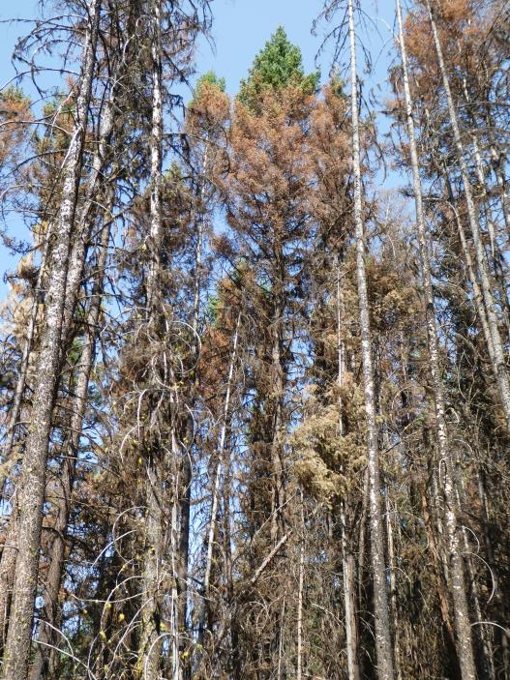
Cryptoporus volvatus fungi form on trees attacked by DFB (or woodborers) and emergence has occurred.
This pouch fungus causes extensive and rapid sapwood decay that results in timber volume loss in bark beetle-attacked trees, or fire-killed trees.
This sign usually occurs 1-2 years after DFB attack
Crown symptoms:
Fire scorch & DFB attack both cause red foliage
Severe scorch (no crown) attacked by DFB – no crown symptoms
Too much noise for accurate detection of DFB attack by crown symptoms
Crown scorch

Slide 14
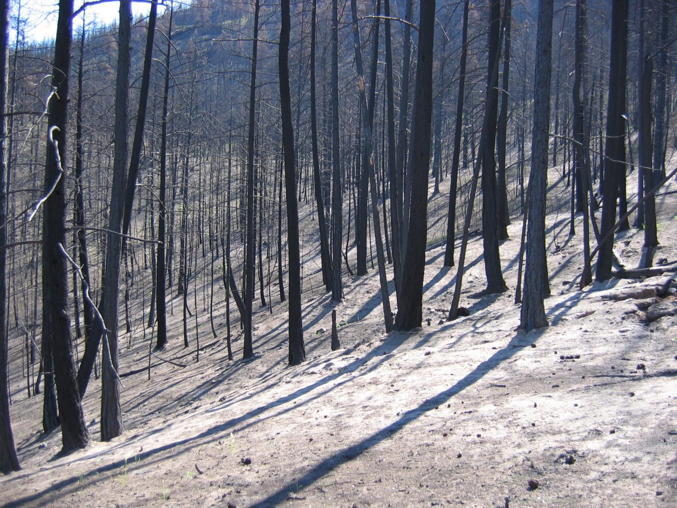
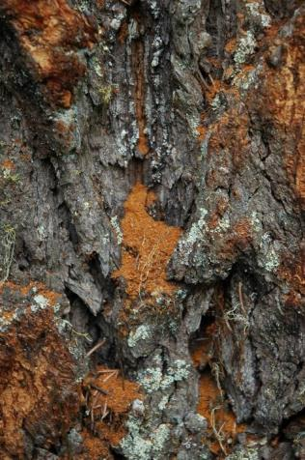
Early season fire – less susceptible in following year due to drying of phloem
Late season fire – most large and medium size trees acceptable to beetles depending on scorch
2017 signs & symptoms
Red-brown boring dust likely caused by secondary beetle attack or 2nd DFB flight
White sawdust – ambrosia beetle attack
Woodborers will attack trees immediately - occupy phloem resource therefore unavailable to DFB
Timing = time of burn time of DFB attack

Slide 15
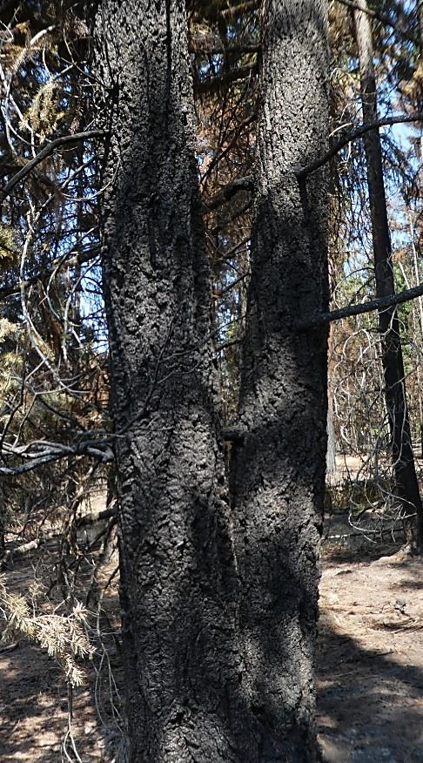
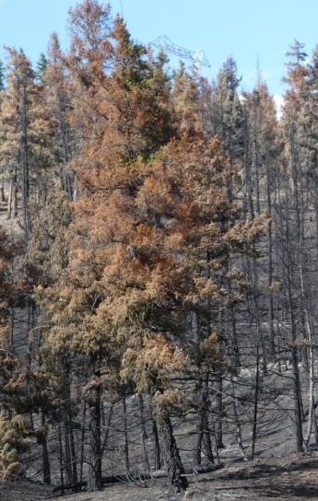
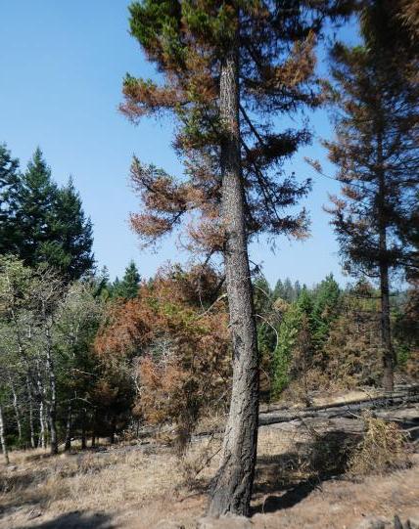
Early season fires:
Severe scorch & no foliage – much is unacceptable to DFB
Light to moderate scorch on large, thick bark fir (red foliage or no foliage) – most are acceptable to DFB
Smaller trees with severe scorch not acceptable to DFB
Crowns fully or partially scorched - acceptable to DFB
Crown symptoms a better indicator of beetle risk than bole scorch

Slide 16
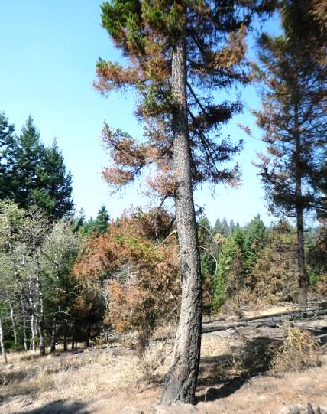
Late season fires:
Very severe scorch & no foliage – most are unacceptable except for very large Fd
Severe scorch & no foliage – should be acceptable
Red foliage or no foliage (light - moderate scorch) on large, thick bark fir - acceptable
Smaller trees – severe scorch not acceptable to DFB but light scorch could be attacked
Crown symptoms a better indicator of beetle risk than bole scorch

Slide 17
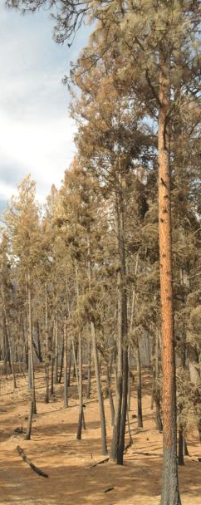
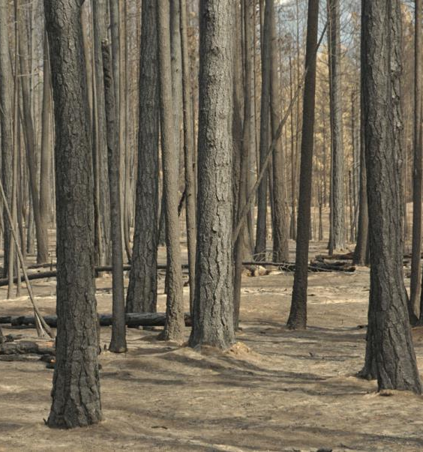
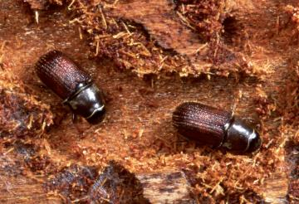
Post-fire environment: things you must consider
In B.C. Douglas-fir and Ponderosa pine are fire-tolerant species and most at-risk to post-wildfire bark beetle attack.
Mortality following wildfire depends on:
bark thickness
tree age and size
type and degree of injury
initial tree vigour, and
post-fire environment

Slide 18
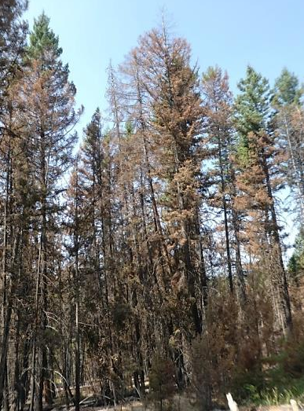
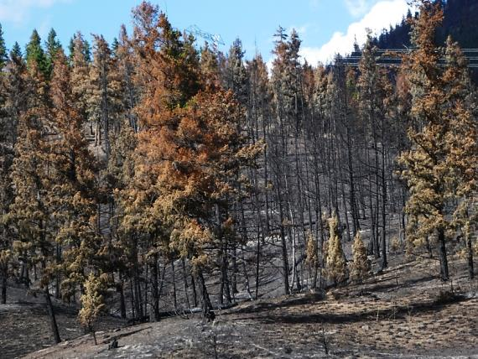
Douglas-fir susceptibility to Douglas-fir beetle post-fire – “Cole’s Notes”
Mortality post-fire:
percent crown volume scorched
percent cambium killed
diameter at breast height (DBH)
Many studies have found crown damage to be the best predictor of mortality, and it is easy to observe.
Post-fire Douglas-fir crowns may have:
green crowns with healthy needles
scorched crowns with brown needles
blackened crowns with blackened twigs and no needles remaining.

Slide 19
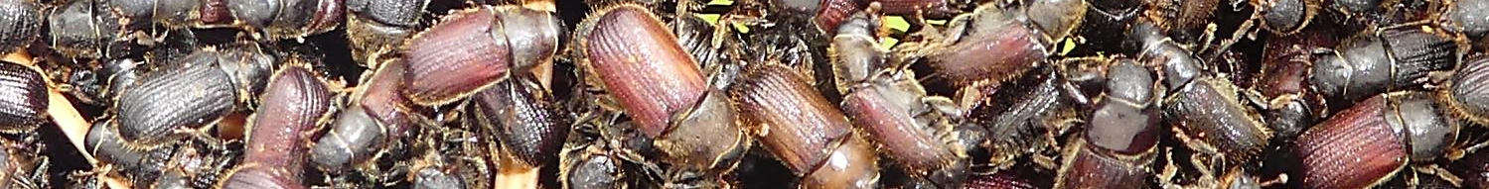
Douglas-fir susceptibility to Douglas-fir beetle post-fire – “Cole’s Notes” continued
DFB prefers large Douglas-fir. Large trees:
have thick bark – protects cambium from injury during a fire
are taller and have higher crowns – lower degree of crown scorch
have a better chance of surviving fire than small trees
have accumulations of duff around their base - basal and root injury from long-term smoldering
may be less vigorous than small trees – less capable of recovering from fire damage

Slide 20
Important ingredients:
Fire severity maps (perimeter, intensity, green areas)
Hazard rating maps for DFB
Extent and severity of Douglas-fir beetle attack (green atk & red atk) – detailed aerial survey maps & ground survey results
Location of felled Douglas-fir (trap tree sites, fire guards, access roads etc.) – remove 2017 trap trees & assess other down material for DFB susceptibility
Critical dates in DFB life history – April to late July
Flexible and innovative management

Slide 21
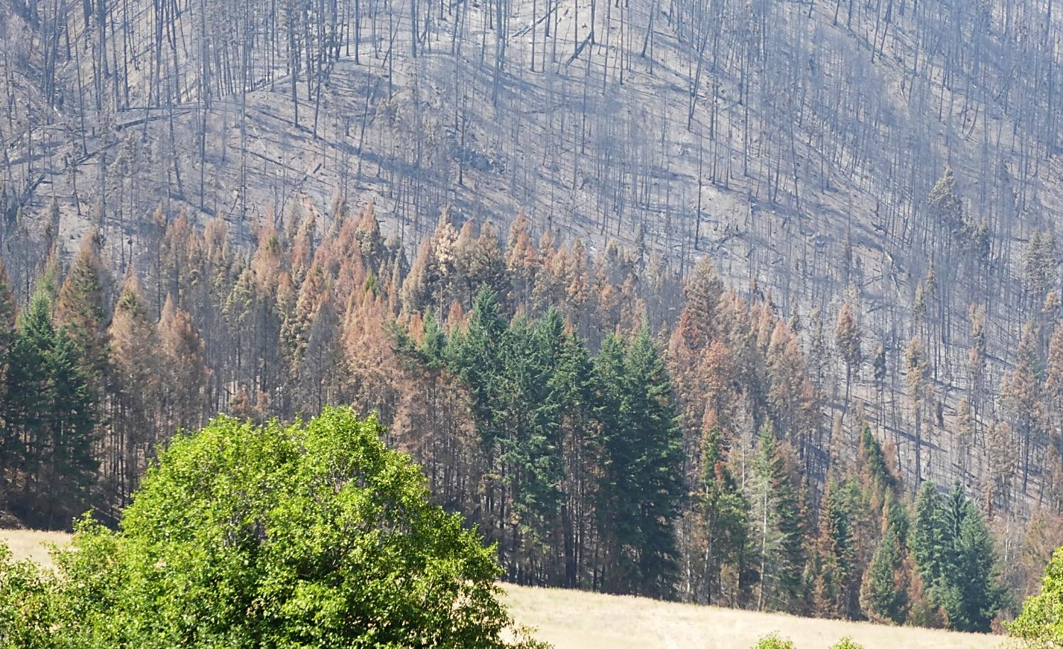
Burn severity and risk to Douglas-fir beetle attack
High intensity burn with cambium scorch – not susceptible
High intensity burn bark intact – susceptible
Moderate to light intensity burn – highly susceptible

Slide 22
Post-fire tree mortality due to Douglas-fir beetle is augmented when beetle populations are present and active near a recent wildfire.
Fire Severity
Light
Moderate
Severe
Overlay fire intensity and 2017 DFB
This shows where the beetle was in June . . .
not where the current green attack is located.

Slide 23
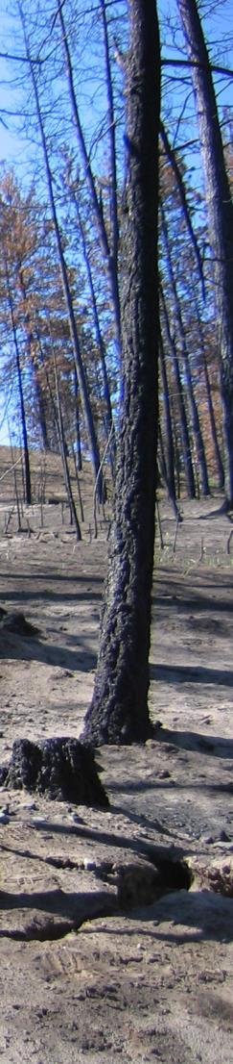
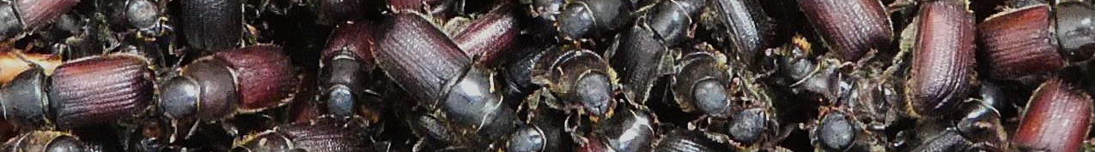
Management sequence & options:
Identify burn severity and assign DFB risk
Only the most severely burnt trees should be removed prior to April 2018.
All harvest after April 2018 should maximize beetle removal with burnt wood salvage.
Identify closest and largest conflagrations of DFB attack (mapped reds & green attack)
DFB still prefers largest trees so optimize blocks based on 1-3 and tree/timber criteria

Slide 24
Management sequence & options:
Scorched trees are attractive host for DFB so conventional trap trees are less effective and most likely a rare resource
Use in-block tree baiting to hold beetles in proposed blocks and to attract DFB populations that are adjacent or dispersing
Locate, assess and treat all Douglas-fir felled in 2017 as trap trees or during fire fighting efforts
Monitor DFB flight period with funnel traps throughout priority salvage areas

Slide 25
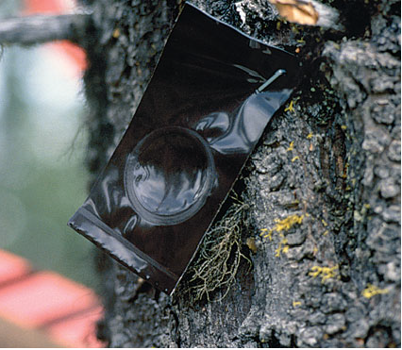
Management sequence & options:
Optimize use of mass trapping techniques in very severely burned areas or clearings near active DFB populations
MCH – use to protect live, green trees from DFB atk

Slide 26


Green (unburned) patches of Douglas-fir may be stressed from fires and summer drought conditions so may be attractive to DFB.
Timing:
ground detection must be done ASAP - prioritize areas
remove 2017 trap trees prior to April 1st, 2018
burnt settings will present a warmer environment thus promoting early season DFB flight
all baits, traps, trap trees, MCH should be in place by April 1st

Slide 27

Thank you.
Questions?

Slide 29




Host = scorched Douglas-fir
Douglas-fir beetle, Dendroctonus pseudotsugae
1° invader – kills trees
Attacks April – July
Red frass on bole, resin streaming, chlorotic foliage
Douglas-fir pole beetle, Pseudohylesinus nebulosus
Douglas-fir engraver beetle, Scolytus unistriatus
2° invader – infests weakened or DFB trees Multiple generations per season
Woodborers, woodwasps, ambrosia beetles
2° invader – decomposers / carnivores
Attack immediately post-fire
Notes:
Bark beetle attack – bark beetles will infest recently fire-killed trees and fire-scarred trees that are still alive. These beetles have the potential to move onto and attack healthy, live trees.
Secondary bark beetles – there are numerous bark beetles that do not attack and kill healthy trees but are attracted to trees under attack by primary bark beetles (e.g. Douglas-fir beetle), stressed or recently killed trees. Boles symptoms are similar to Douglas-fir beetle so identification must be verified by checking under the bark. These beetles seldom build to numbers that can pose a threat to green healthy trees.
Woodborer, ambrosia beetle and wood wasp damage – these insects damage the sapwood portion of burnt trees. Trees must be severely stressed or dead for these insects to attack. Bole symptoms include reddish boring dust (woodborers) or white sawdust (ambrosia beetles). These bole symptoms could be mistaken for bark beetle attacks so verification must be done. These insects will NOT affect living, vigorous trees.

Slide 30


Mass trapping option:
place 1-3 traps in key management areas
place in severely burned areas or clearings where spillover is less a problem (in these circumstances it may be a good thing!)

Slide 31



Management with funnel traps & pheromones:
♂(♀ )
can run all summer
catch is 2 to 3 x trap trees
Spillover!! May not be an issue in post-fire scenarios
100m from live Fd; optimize use of severely scorched sites for trap deployment
maintain bi-weekly
new baits mid-June
protect residual trees with
MCH (200m)
Cleridae

Slide 32

Development of management plans immediately following fire can be difficult due to the timing and uncertainty of many interacting factors. It is important to consider the multi-faceted ecological and economic aspects of post-fire forest restoration efforts in management plans.
Predicting Douglas-fir post-fire mortality can be further confounded by Douglas-fir bark beetle attacks. Douglas-fir beetles rarely attack trees smaller than 25 DBH. Therefore, in burned areas with active Douglas-fir beetle populations, large Douglas-fir trees that could have survived fire-injuries alone are often attacked and killed.

